Slide 1
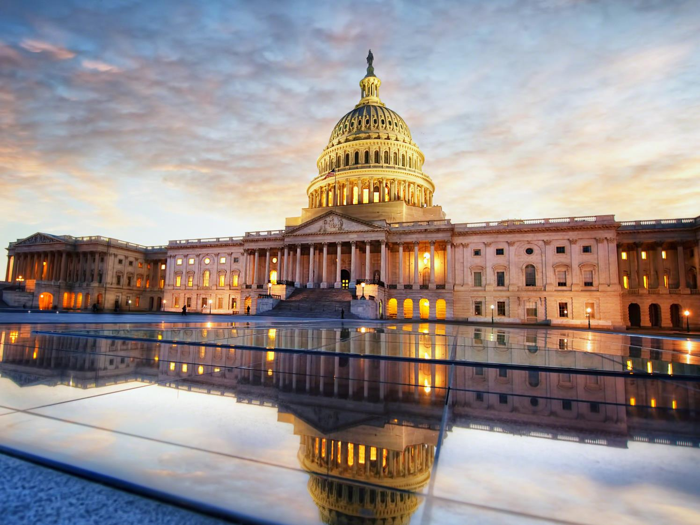

Slide 2
You should understand:
What are the characteristics of democracy and why are they important?
What elements and conditions help to allow a democracy to flourish?

Slide 3
A democracy is a governmental system in which the sovereign power rests with the people.
In a democracy, the elected representatives are responsible for answering to the popular will of the people.

Slide 4
Government works to secure an equal opportunity for people to develop their own abilities.
Government is based on majority rule through the people’s elected representatives, but respects the rights of minorities.

Slide 5
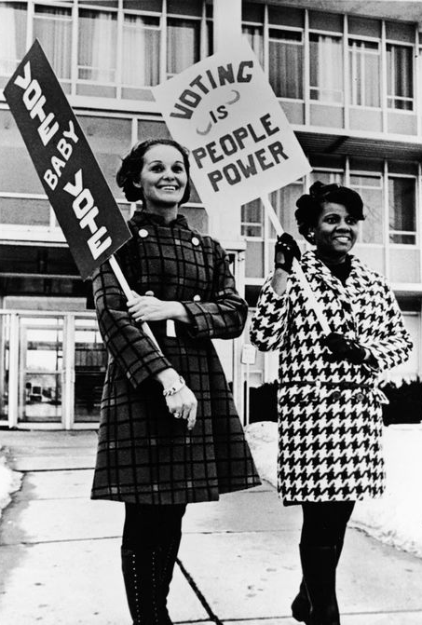
Government is based on free and open elections in which every citizen has the right to vote, every vote has equal weight, and candidates for office can freely express their views.
Political parties choose candidates for office, respect the voters’ decision in elections, and act as loyal opposition.

Slide 6
Certain conditions or environments favor the development of a democratic system of government.
Countries where citizens participate fully in civic life are more likely to maintain a strong democracy.
Stable, growing economies with a large middle class help strengthen democracies.

Slide 7
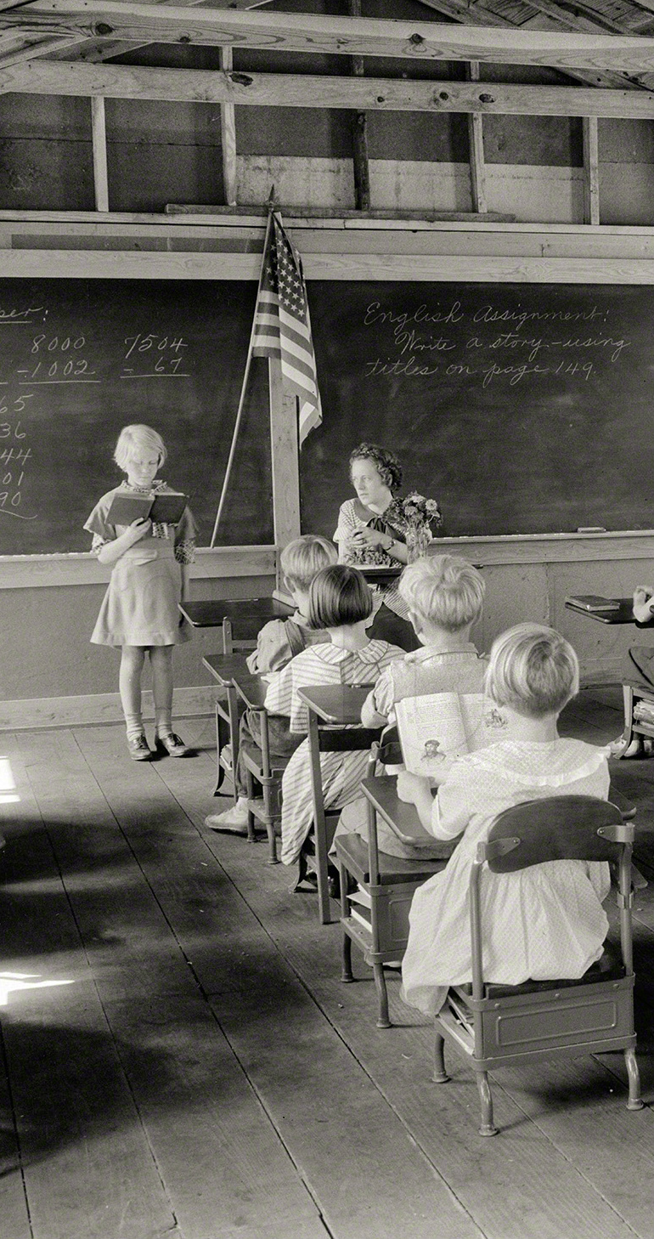
A public school system open to all people helps promote democracy.
The people accept democratic values such as individual liberty and equality for all in a social consensus

Slide 8
A network of voluntary organizations:
Economic groups, religious groups, and many others
These exist independent of government and help a democracy to flourish.

Slide 9
You will now be split into 5 groups based on these 5 elements of democracy:
1. Citizen participation
2. Stable economy with a large middle class
3. Public school system
4. Social consensus of democratic values
5. Network of volunteer organizations
Why is your group’s element the most essential?

